Slide 1
Barnstable Town Council
Update on Wastewater Efforts In Barnstable
Department of Public Works
February 18, 2021

Slide 2
Update Since January
CWMP
  Single EIR approved by MEPA
  Cape Cod Commission: Request for 208 Consistency Review Submitted
JBCC
  Negotiations underway as of 2/11/21
Mothers Park
  Continuing to work road ownership
Route 28 / Yarmouth Road - MassDOT
  Continue to coordinate sewer and water infrastructure to be installed as part of project.

Slide 3
Update Since January
Projects
  Strawberry Hill Road Project
    Finalizing design of sewers and pump station
    Continuing coordination with Vineyard Wind
    Anticipating Fall construction start
    Coordinating SRF paperwork
  Rte 28 East (pump station & Sewering at Phinney's Lane and 28)
    Preliminary Design continues
    Coordinating/partnering with Hyannis Water to remove “dead-ends” in water system as part of project.
    Spring 2022 Construction Start Target
  Long Pond, Phinney Lane, and Rt 28 to Rt 149 surveys
    Long Pond – Draft being reviewed by Town Surveyor
    Phinneys & Rte 28 - Drafts anticipated in February
    Next Steps – Commence preliminary design effort (in-house)

Slide 4
Other Wastewater Projects
Projects
  Rendezvous Lane Pump Station
    Construction begins first week in March
  Solids Handling Rehabilitation
    Finalizing Drawings
    Received permission to advertise from SRF
    Anticipate advertising in March
  Pump Station Improvement Program
    Finalizing Drawings
    Received permission to advertise from SRF
    Anticipate advertising in March
  Effluent Flow Meter Installation - Complete
  Bearses Way Vacuum Sewer Decommissioning & Shared Use Path
    Submitting 75% design to MassDOT next week.

Slide 5
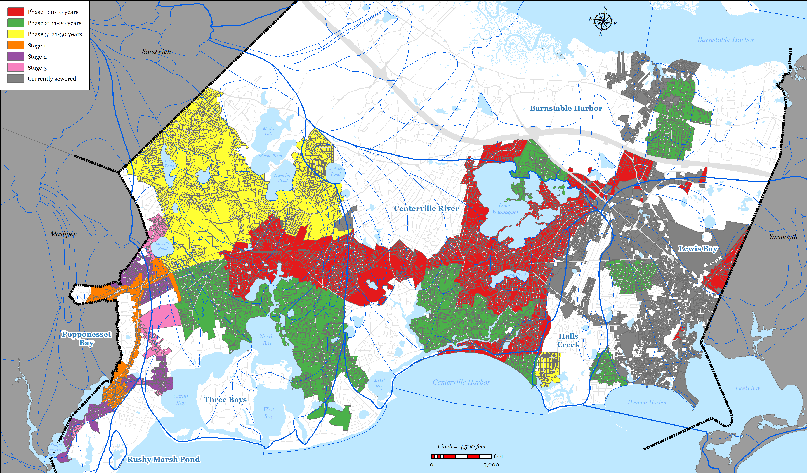
Phasing Plan

Slide 6
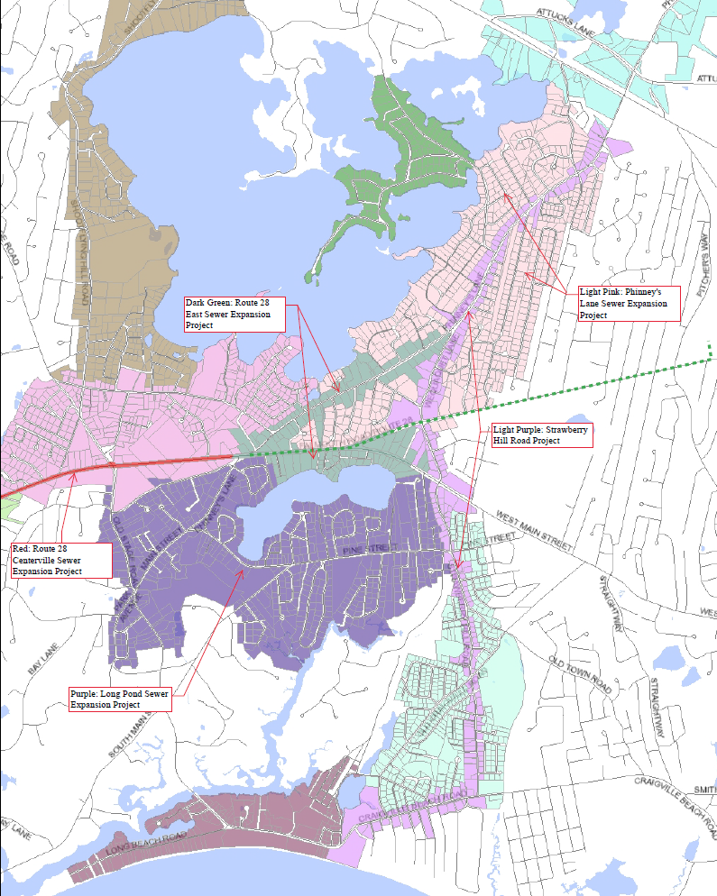
Phase I Projects - East

Slide 7
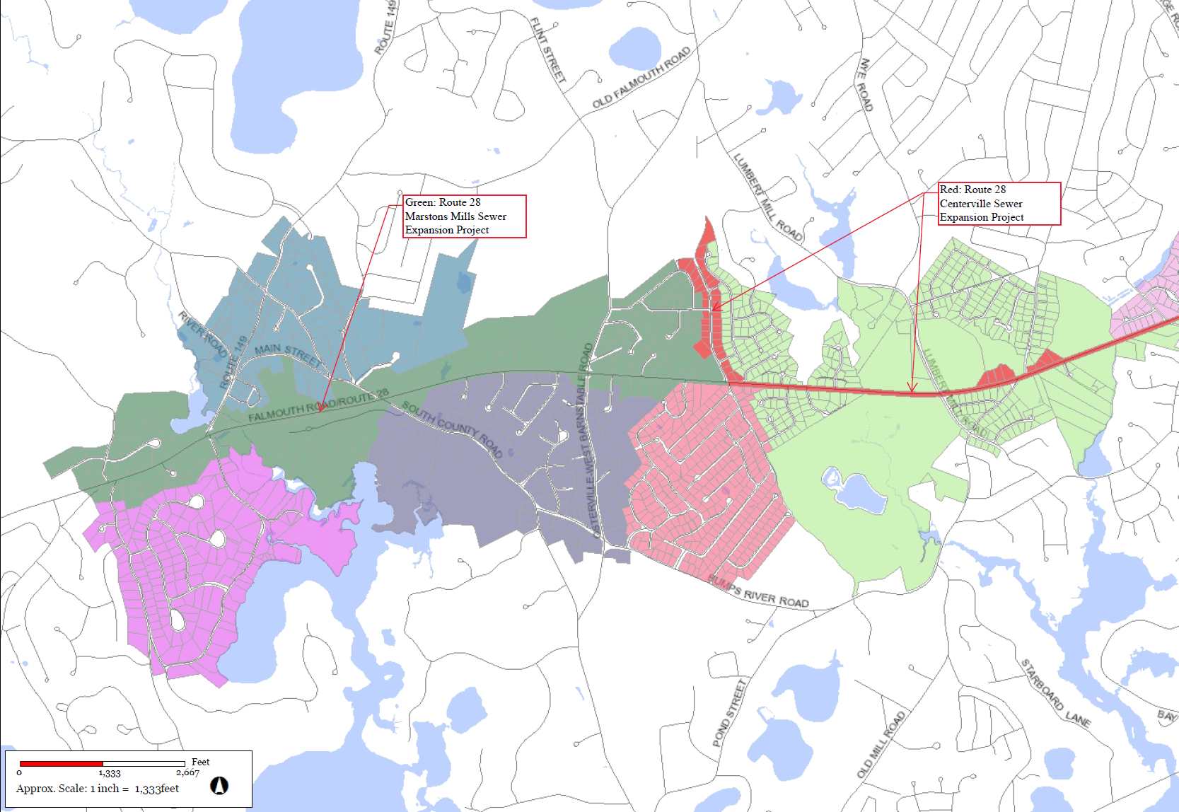
Phase I Projects - West

Slide 8

Discussion?

