Slide 1
Asset Management Advisory Committee
February 17, 2021
Town of Barnstable

Slide 2
Meeting topics Recap
2-27-20 Focus on Large buildings MMills, Cotuit, Armory, 200 Main Street.
6-9-20 Specific focus on options for Cotuit Elementary. Village input sought.
7-23-20 Continued Village input. Ideas for subdividing parcel and demolition of building.
8-26-20 DPW input – costs and challenges for demolition (Intro of CIPs for both empty schools for demo FY 22).
9-29-20 Update on Cotuit Water District interest in Cotuit Elementary property. Return to disposition discussion for other Town owned parcels.
12-1-20 Package for second round sale, also discuss Specific Properties for Separate RFP – Mitchel’s Way and 164 Route 149. AFHT

Slide 3
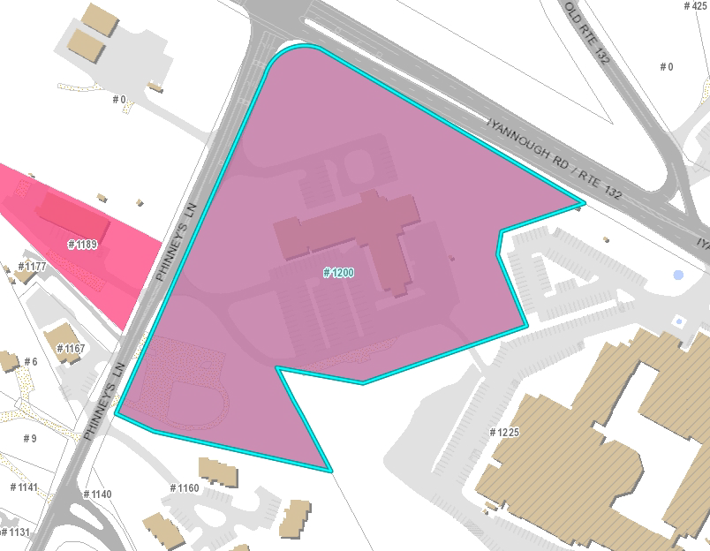
1200 Phinneys Lane, Hyannis : 274 P: 031
Location of new parking lot for Cape Codder
Note: Location of cut through to back of police parking lot
Location of former VFW

Slide 4
1200 Phinneys Lane, Hyannis : 274 P: 031
Acquired (12/1/2001)
Usable space ~70,750 sq feet = 1.3 to 1.6 acres
(Former VFW Map: 273 Parcel: 088)
located next to Police department
Vacant Parcel
Easement (Pipe lines for property across the street)
Not currently Sewered (In Phase I plan)
Options
Sell to developer with restrictions
Spend pre development money through CPC and Affordable Housing Trust to see what can be built?

Slide 5
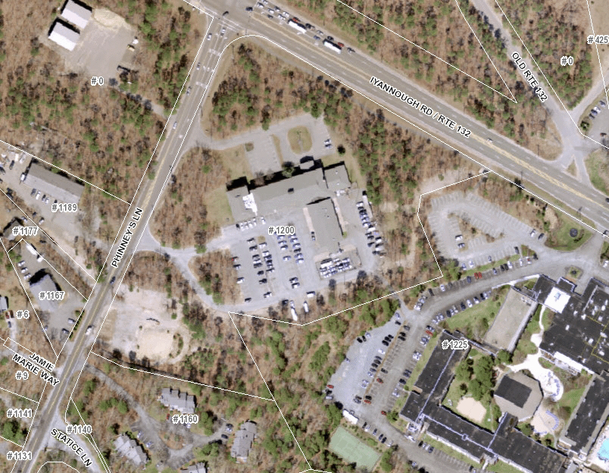
Location of parking lot for Cape Codder
Location of former VFW
BPD 2014 Aerial flyover

Slide 6
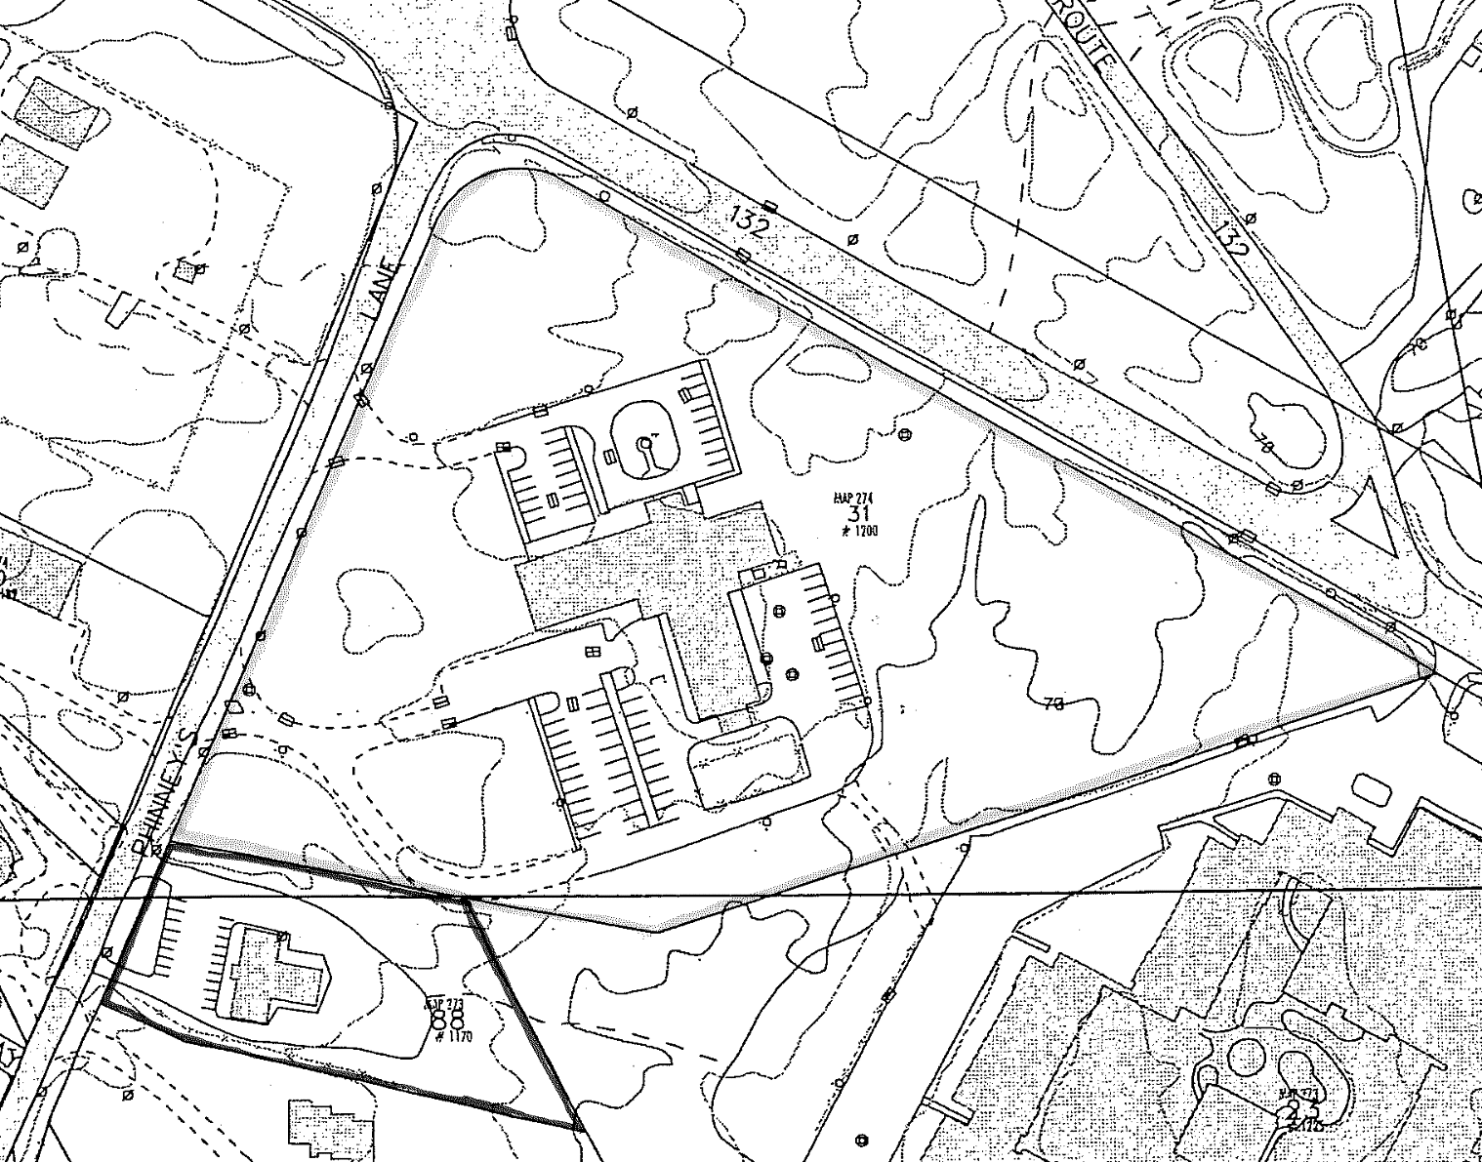
M:274 P: 031
Location of new parking lot for Cape Codder to be built
BPD 1998 parcel maps pre Land Swap pre addition to BPD station
Location of VFW
M:273 P: 088

Slide 7
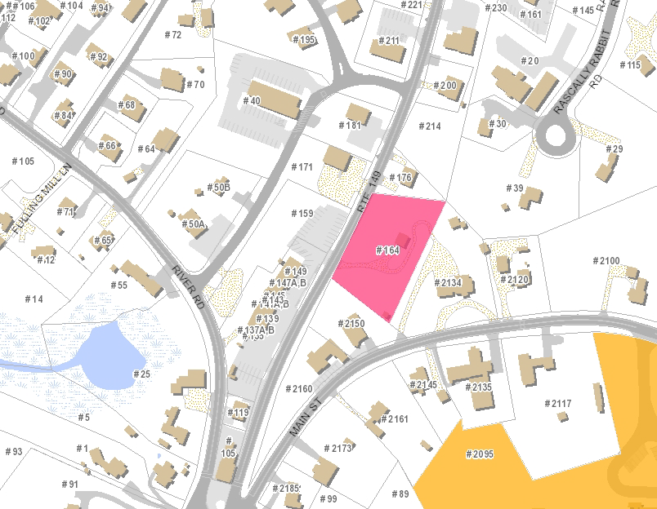
164 Route 149, Marstons Mills M: 078 P: 074
Property
Location

Slide 8
164 Route 149, Marstons Mills M: 078 P:074
164 Route 149, Marstons Mill
Acquired 7/11/2016
Paid $265,000 (Land assessed at $123,300)
0.85 acres (Modified)
Contains a building -- Possible tear down and rebuild, depending on condition.
Non Sewered. (Septic System status to be verified)

Slide 9
164 Route 149, Marstons Mills
2/17/21 NEXT STEPS
Appraisal to be done -- Based on anticipated value and current condition (See condemned status note below)
Certified Plot plan being prepared (On going effort)
Issue of defining the easement for parking spaces on 149 (On going effort)
Possible future sidewalk easement to be pursued before we put out the final sale.
Building Department inspection of structure to determine condition. (May have been condemned)

Slide 10
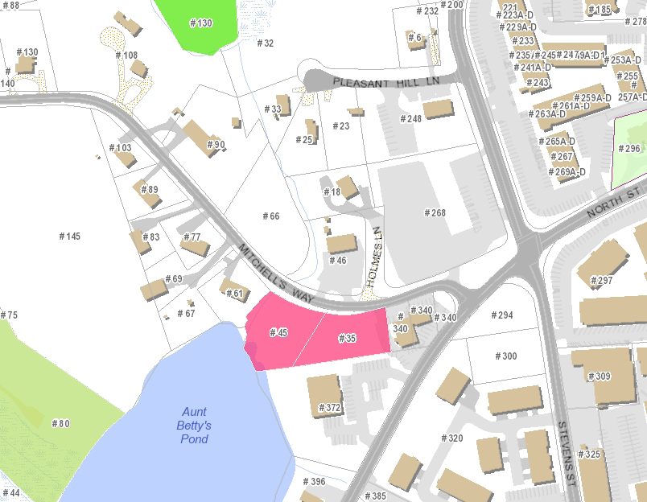
35/45 Mitchell's Way, Hyannis (M: 308 P: 273/001 + 273/002)
Property
Location

Slide 11
35/45 Mitchell's Way, Hyannis (M: 308 P: 273/001 + 273/002)
Acquired 1/12/1999, 2 parcels (.43 and .45 acres) Non Sewered (currently)
Possible assemblage into one parcel and placement of a single unit?
Possible encroachment issue with abutter
Land touches waters edge of Aunt Bettys Pond
There had been a desire to see this be used for affordable housing.
2/17/21 update
Had been presented to Affordable housing Trust.
Suggestion that it be held – no action taken for now.

Slide 12
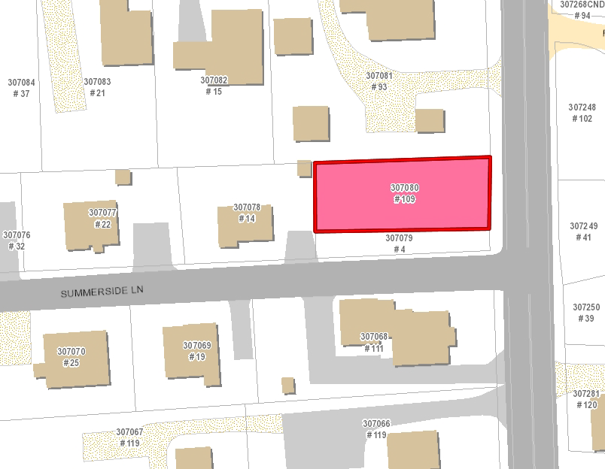
109 Sea Street, Hyannis (M: 307 P: 080)
Property
Location

Slide 13
109 Sea Street, Hyannis (M: 307 P: 080)
Acquired 6/29/2004, (.11 acres) Non Sewered (currently)
Possible assemblage into one parcel and placement of a single unit ?
Abutter is Housing Assistance Corps (1988 - 0.03 acres – part of larger purchase)
This could be a location for affordable housing.
Assessed value - $37,200
Tax Possession property
2/17/21 update
Had been presented to Affordable housing Trust.
Suggestion that it be held – no action taken for now.

Slide 14
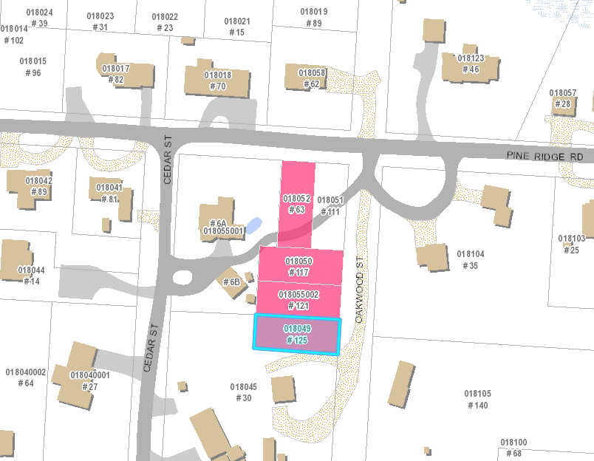
63 Pine Ridge Road (M: 018 P: 052) 117 Oakwood Road (M: 018 P: 050) 121 Oakwood Road(M: 018 P: 055/002) 125 Oakwood Road (M: 018 P: 049)
Property
Location in Cotuit

Slide 15
63 Pine Ridge Road (M: 018 P: 052) 117 Oakwood Road (M: 018 P: 050) 121 Oakwood Road(M: 018 P: 055/002) 125 Oakwood Road (M: 018 P: 049)
Acquired in 2004,(.36 acres combined) Non Sewered
Offered in Round 1 as a block – no bids
2/17/21 (reserve for next RFP)
Possible unbundling or change to bundle
Intensify abutter notification
Final Judgements in hand for 2
2 parcels given by owner 2004
Assess value – set minimum bid. Each parcel assessed at $7,200.

Slide 16
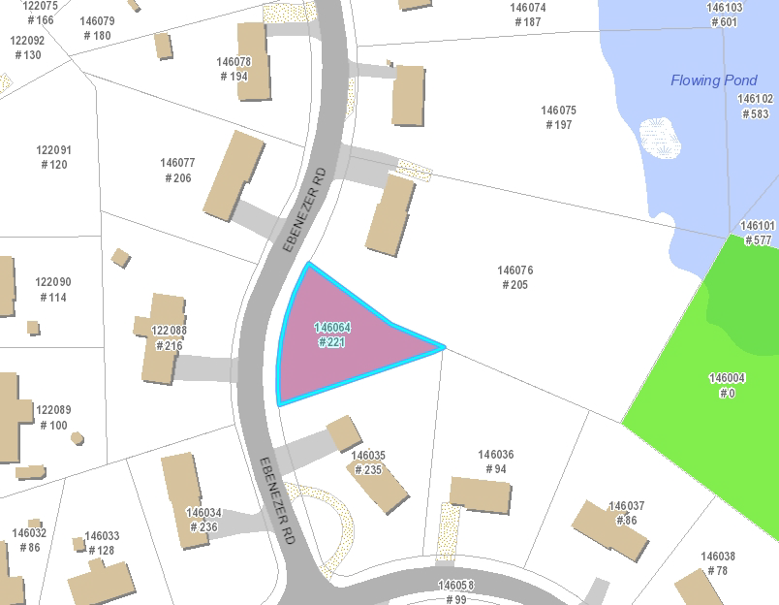
221 Ebenezzer Road, Osterville (M: 146 P: 064)
Property
Location

Slide 17
221 Ebenezzer Road, Osterville (M: 146 P: 064)
Acquired 4/15/1986, (.21 acres) Non Sewered
Unused utility easement still exists on property
Offered in Round 1, high bidder withdrew
Second bidder not interested in purchase.
Assessed value - $102,300
2/17/21 (reserve for next RFP)
Appraisal to be done (Based on damages for easement)
Locate official information on unused utility easement (unsuccessful in this effort to date)
Possible overlay into CWMP plans with DPW (Initial discussion with DPW on pump locations sites for Phase I on going)

Slide 18
91 South Street, Hyannis (M: 326 P: 127)

Slide 19
91 South Street, Hyannis (M: 326 P: 127)
Acquired 12/7/1925, (.16 acres)
Assessed value - $214,100 for the land, and $17,600 for the building
Building built in 1950 – 440 sq feet. Old pump station.
Current WPC plans do not include this property.
Maintenance Liability to Town.
Building is in the Hyannis Downtown Historic District, and would possibly need to be vetted through them for disposal.

Slide 20
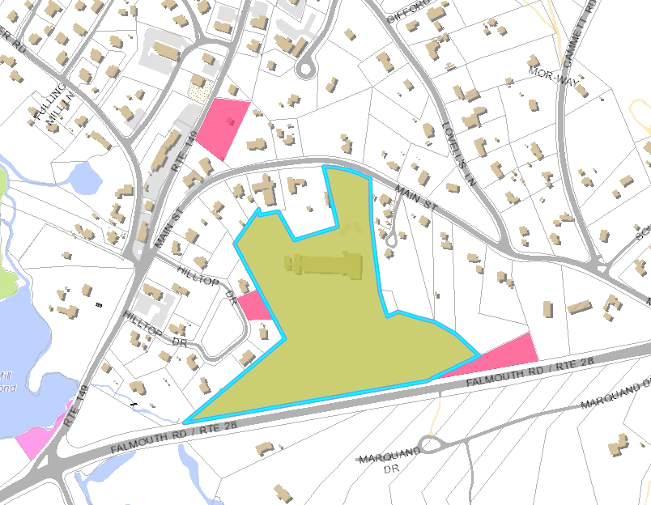
2095 Main Street, Marstons Mills (Map: 077 Parcel: 026)
Property
Location
Two addtl. Muni Parcels

Slide 21
2095 Main Street, Marstons Mills (Map: 077 Parcel: 026)
School Closed 2009
13.11 acres (Possible additional 1.09 acre total with two adjoining Municipal Parcels)
Encumbered with a dilapidated school - $700,000 removal cost est. (Haz Mat Abatement)
Time table for Municipal removal - 2021 CIP – work done in 2022
Non Sewered (currently)
Phase 1 of Wastewater plan – W Villages Treatment Plant – Convert to Pump Station. Flow back to WPC
Potential seven to nine years out for sewering

Slide 22
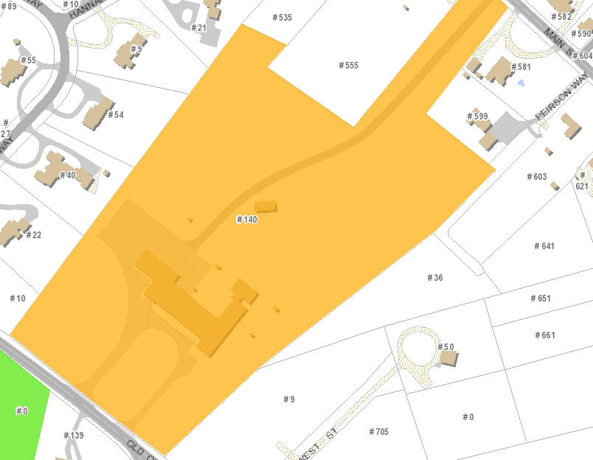
Former Cotuit Elementary School 140 Old Oyster Road, Cotuit (Map: 021 Parcel: 008)
Tennis courts and ball field
School Building

Slide 23
Former Cotuit Elementary School
140 Old Oyster Road, Cotuit (Map: 021 Parcel: 008)
13.5 acres – not sewered.
Only public ballfield and tennis courts in village
Closed 2009
Leased to Waldorf School for ten years. Ended in 2019.
High cost to renovate ($4Million +)
Demo cost ~$800,000 due to Haz Mats

Slide 24
Former Cotuit Elementary School
Two presentations to AMAC via zoom(6/2020 and 7/2020)
Well attended by Village. Plenty of ideas. Affordable housing, Market rate housing, Open space, veterans center, community center, transfer to Fire district.
Village Concerns about “over building”, water quality, waste water and proximity to drinking wells and salt water. Loss of village open space.

Slide 25
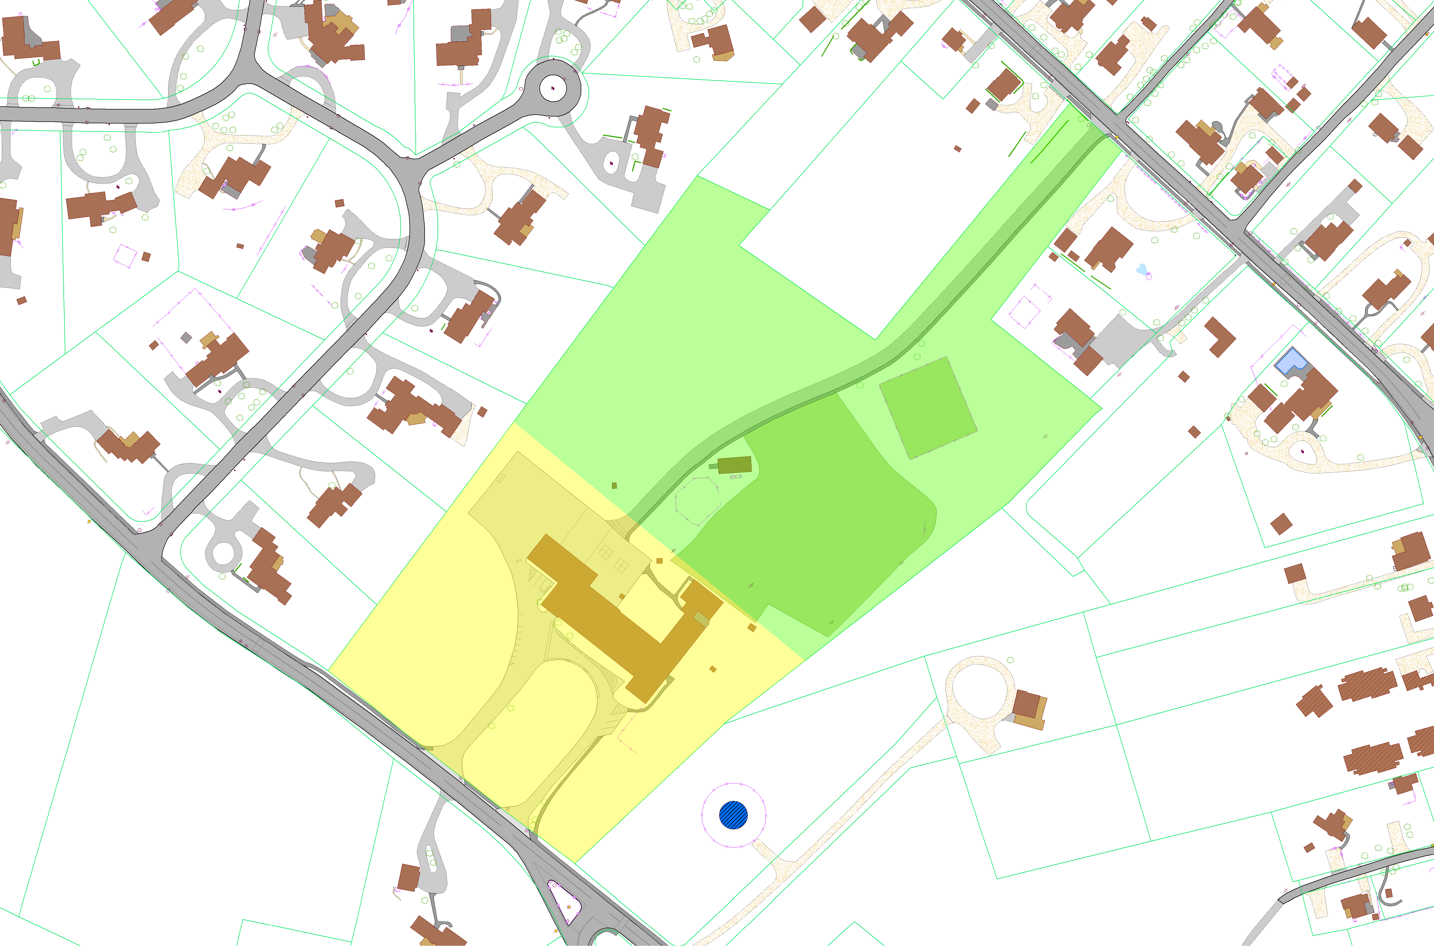
SCR
7.9 ac
Legend
To w n Bo unda ry Fenc es
Pa rc els FY2020 Gua rdra ils
123-456 Pa rc elNum b ers ^{Reta ining Wa lls}
Sto ne Wa lls
OtherWa lls
Appro x. Build ing
Build ings
Do c ks / Piers
Dec ks
Bo a rd wa lks
Pa tio s
Strea m s
Ab o veGro und Swim m ing Po o ls
In Gro und Swim m ing Po o ls
Ma rsh Area s
Pa ved Wa lkwa ys
U npa ved Wa lkwa ys
Wo o ded Area s
Pa ths
Street Trees
Mo num ents
Pa ved Med ia ns ^{Bo lla rd}
U npa ved Ro a ds ^{Ma ilb o x}
Pa ved Drivew a ys N ^{Ca tc hb a sin}
U npa ved Drivewa ys # Fla gpo le
Pa inted L ines
Pa ved Pa rking L o ts
U npa ved Pa rking L o ts
Brid ges
Ra ilro a d
^{Spo t Eleva tio ns (NAV D88)} K" U tilityPo lew / L ight
To po 10 ft Co nto urs (NAV D88) K U tilityPo lew /o L ight
To po 2 ft Co nto urs (NAV D88) _{= Wind Turb ine}
Sto neJetties / Revetm ents
Co nc reteJetties / Revetm ents
Wo o d Jetties / Revetm ents
Go lfArea s
Spo rts Area s
# 1234 Ad dress Street #
Hedges
Dra ina geDitc hes
TODD WAY
Wa terBo d ies
Sta irw a ys
EECHAM WAY
EAST LN
Pa ved Ro a ds
HANNAH CIR
e W G D G"
)d
Ma nho le
Sign
Street L ight
MAIN ST
To wer
Tra ffic Signa l
U tilityBo x
FuelTa nks
Wa terTa nks
Data Source
Hum a n-m a d efea tures, hyd ro gra phy, to po gra phy, a nd
vegeta tio n wereinterpreted fro m 2014 & 2008 a eria lpho to s a nd m a yha veb een upd a ted fro m m o rec urrent so urc es. Pa rc el
lines wered igitized fro m FY2020 To wn o f Ba rnsta b leAssesso r’s ta xm a ps.
Disclaimer
Pa rc ellines o n this m a p a reo nlygra phic representa tio ns o f
Assesso r’s ta xpa rc els. Theya reno t truepro pertyb o unda ries
a nd d o no t represent a c c ura te rela tio nships to physic a lo b jec ts o n them a p suc h a s b uild ing lo c a tio ns.
This m a p is fo rpla nning purpo ses o nly. It is no t a d equa tefo r lega lb o und a ryd eterm ina tio n o rregula to ryinterpreta tio n. This m a p d o es no t represent a n o n-the-gro und survey.
Enla rgem ents b eyo nd a sc a leo f1”=100’m a yno t m eet esta b lished m a p a c c ura c ysta nda rd s.
PEIRSON WAY
0
Ã¿^{N}
1 inch = 60 feet
Feet
0 15 30 60 90 120
W
S
E
FIL E: Co tuitSc ho o lPa rc el.m xd J.A.B. 04/10/2020
NARROWS WAY
Town of Barnstable
GIS Unit
http://www.to wn.b a rnsta b le.m a .us
367 Ma in Street, Hya nnis, MA 02601 (508) 862-4624
5.3 ac
O
LD OYSTER RD
WEST ST
HIGHLA
N
D AVE

Slide 26
Former Cotuit Elementary School
Cotuit Fire district confirmed property is within the critical Zone 2 wellhead protection area
Edge of property within 800 feet of drinking water wellfields.
Identified concerns include, wastewater discharges, storm water infiltration and fertilizers
A requested goal is a net reduction of Nitrogen loading to the groundwater.
For housing, suggested use of innovative alternative wastewater facility (septic system) and limit number of units/bedrooms.
Property not identified in CWMP for sewering

