Slide 1
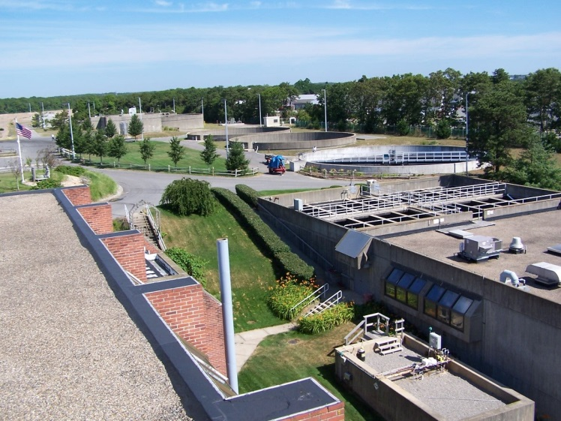
Town of Barnstable, MA Financing Plan
Comprehensive Wastewater Management Plan
Notes:
2 documents passed out.
The plan included in our CWMP submission but we are not tied to it.
Very dirigible plan. Can control and steer it in many ways.
Provides a roadmap that we can follow; adjusted as needed to changing financial conditions and identifies the major policy decisions to be made

Slide 2
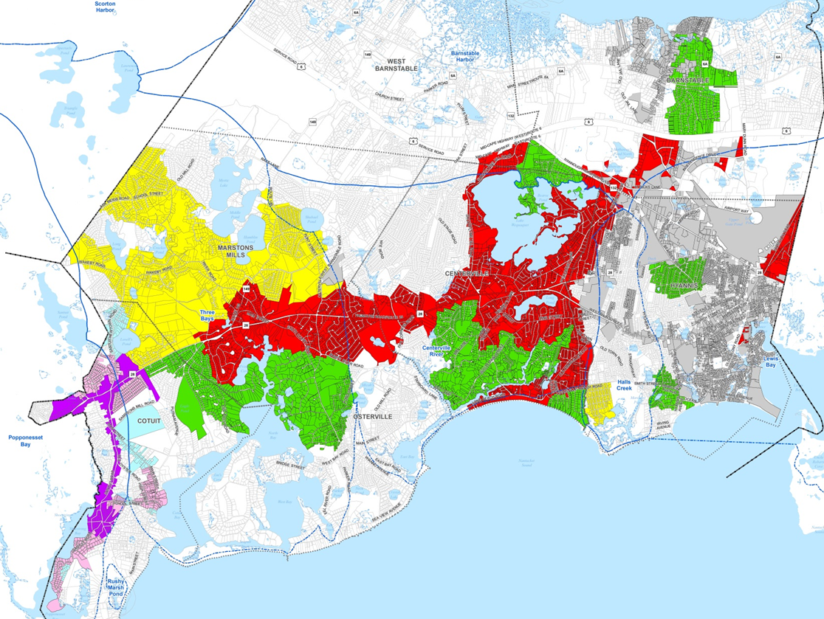
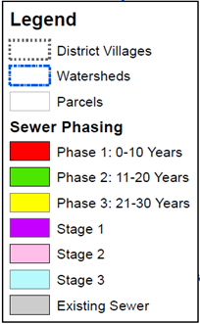
Sewer Phasing
Total estimated construction costs are $863 million;
$87,953 average per parcel
Notes:
$663 million; includes $30 million for potential conveyance to JBCC, another $200 million for inflation; total of $863 million.

Slide 3
Program Costs Breakdown
Total $1.062 Billion
Collection & Conveyance System Costs
$640 Million
Treatment Systems Costs
$224 Million
Financing Costs
$168 Million
Project Management
$30 Million
Notes:
We have not commissioned any studies on the economic impact to the town as a result of this type of infrastructure investment.

Slide 4
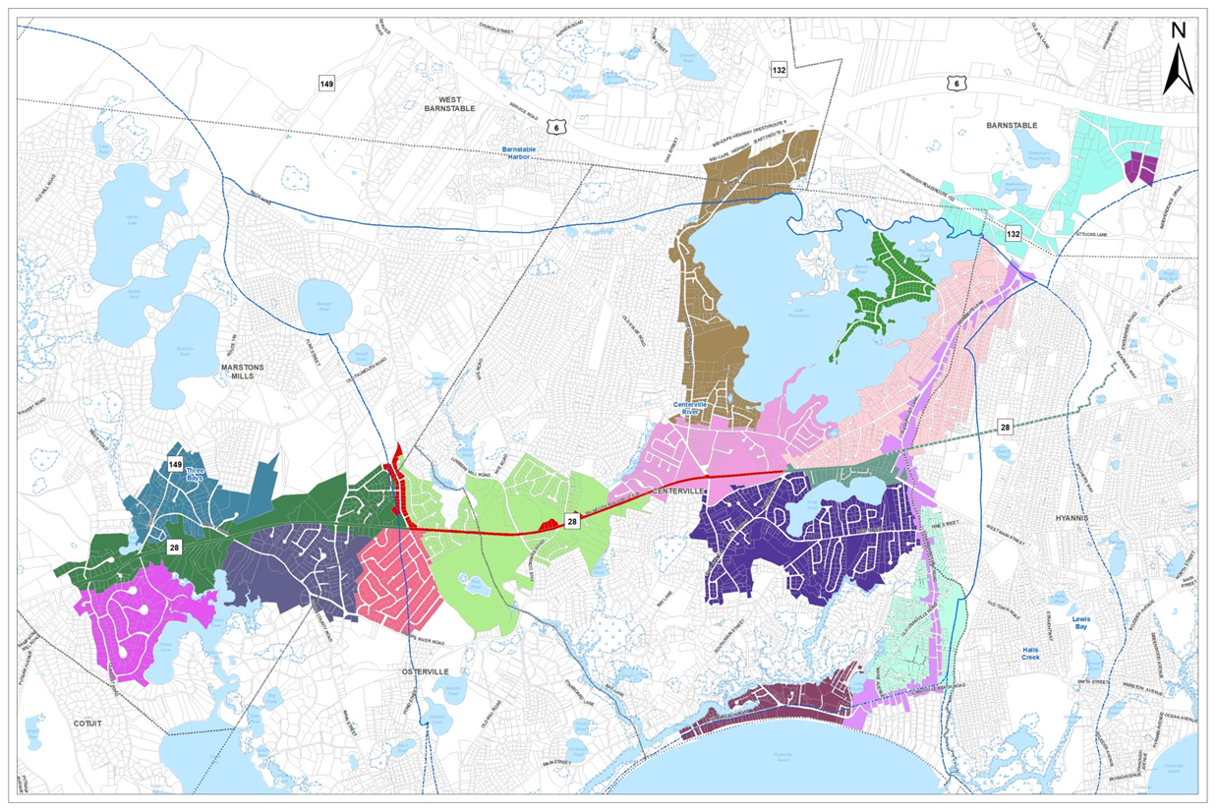
Phase I Draft Project Segregation
Notes:
Illustrates how the first 10 year phase could be separated into projects.
Our focus has been concentrated more on the first phase than phase 2 and 3
Estimated cost is $280 million for collection and conveyance and $79 million for treatment systems

Slide 5
Timeline
Projects commence in FY 2020 and end FY 2050 – 30 years
Bond financing commences in FY 2020 with first loan payment in FY 2021
Last loan is issued in FY 2050 with payback commencing in FY 2051
Last loan payment is FY 2070 – 21 years after completion of construction in FY 2050
Notes:
This is a 50 year plan.
Project implementation runs for 30 years with the last bond issue in year 30 payable back over 20 years.
Last loan payment is in FY2070.

Slide 6
Financing Construction Costs
Issue municipal bonds over a 30 year implementation period
Estimated principal subsidies on bonds of $112 million
Many bonds to be issued through the Massachusetts Clean Water Trust
  Nutrient Enrichment Reduction Loan Rate = 0%
  Housing Choice Community rate = 1.5%
  Standard loan rate = 2%
Capital market rates have averaged 2.5%
CWMP Financing Plan assumes bonds are amortized over 20 years using level payment method with an average 2% rate
Notes:
Municipal bonds will be issued to finance the $864 million of construction costs.

Slide 7
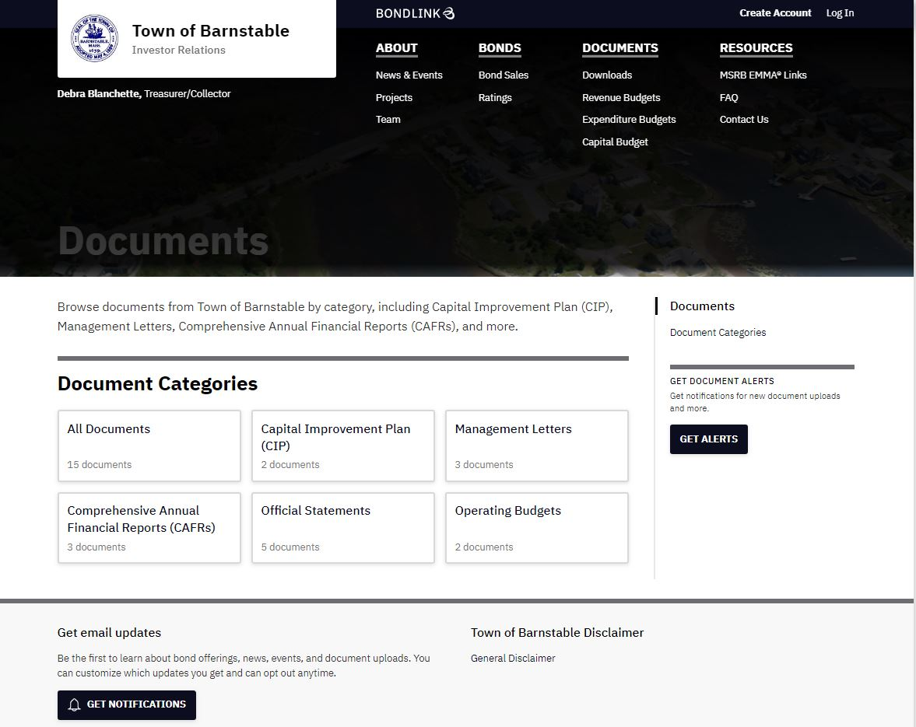
New Investor Relations Website www.barnstableinvestorrelations.com
Goals
  increase demand for our bond issues in the capital markets
  Maintain strong investor relations
  Increase transparency
Relevant information for investors is housed on one site
Investors are notified automatically of new information
Track investor activity
Ability to produce “roadshows”
Notes:
The EMMA website is funded and operated by the Municipal Securities Rulemaking Board (MSRB), the self-regulatory organization charged by Congress with promoting a fair and efficient municipal securities market. EMMA is designated by the U. S. Securities and Exchange Commission as the official source for municipal securities data and disclosure documents. The website provides free public access to objective municipal market information and interactive tools for investors, municipal entities and others. EMMA supports municipal market transparency but is not a platform for buying or selling bonds.

Slide 8
Program Funding Sources
Cape & Islands Water Protection Fund
Sewer Assessments
Local Rooms Tax including tax on short-term rentals
Sewer Utility Charges
Investment Earnings
Systems Development Charges
General Fund Contribution
Local Meals Taxes
There are no targeted federal or state grants included in the plan. Any direct aid for the program will only improve the financial position of the program.

Slide 9
Cape & Islands Water Protection Fund
Dedicated fund within the Massachusetts Clean Water Trust
Source of revenue is a 2.75% excise tax on traditional lodging and short-term rentals
Overseen by a Governing Board comprised of representation from every member town on Cape Cod
Town Manager is Barnstable’s representative
Notes:
Also 3 non-voting members on the board ; ED of CCC and MVC and TM of Nantucket

Slide 10
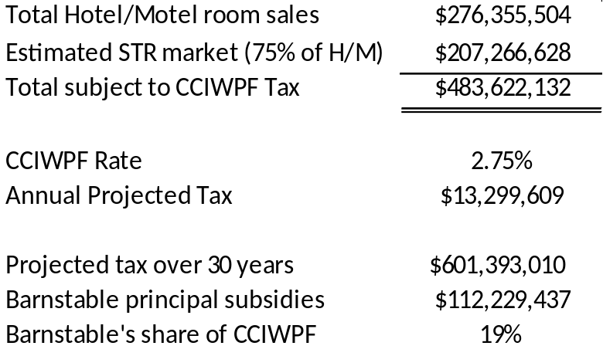
Cape & Islands Water Protection Fund
Projected Fund Revenue
The Fund received its first payment of $2.9 million representing the month of July.
Notes:
$2.9 million = $105 million is sales cape wide.
Barnstable $50,876,100 18%
Yarmouth $44,543,817 16%
Provincetown $36,825,116 13%
Chatham $36,755,625 13%
Falmouth $24,382,780 9%
Brewster $19,830,950 7%
Harwich $17,119,800 6%
Dennis $13,072,200 5%
Truro $9,261,975 3%
Eastham $7,341,800 3%
Sandwich $6,311,925 2%
Orleans $3,939,183 1%
Wellfleet $2,910,700 1%
Mashpee $1,787,700 1%
Bourne $1,395,833 1%
Total $276,355,504

Slide 11
Hotel/Motel Room Tax Trend
One-third of this revenue ($1 million) is dedicated to Sewer Construction & Private Way Fund
CWMP Financing Plan includes a 3% average annual growth in revenue

Slide 12
Local Meals Tax Trend
All of this revenue is dedicated to the Sewer Construction & Private Way Fund
CWMP Financing Plan includes a 4% average annual growth in revenue

Slide 13
Short-term Rental Tax
Hotel/Motel room sales total $51 million in FY 2019 generating over $3 million in annual rooms tax
STR business estimated to be 75% of hotel/motel
Will take several years to mature
Eventually exceeds $2 Million per year
Projected growth of 3% per year
100% of revenue is dedicated to sewer & water management

Slide 14
Sewer Assessments
Can include 2 components – Specific Benefit Facilities (SBF) and General Benefit Facilities (GBF)
  SBF – include but not limited to, sewer mains to which a lateral line from an individual abutting property can be connected; and pumping stations that are required to service a specific project area
  GBF – include but not limited to, pumping stations, trunk and force mains, lands, rights-of-way, and easements which will provide a benefit or advantage to an area exceeding that served by the specific benefit facilities. Ordinarily general benefit facilities will serve a major part of a pumping district.

Slide 15
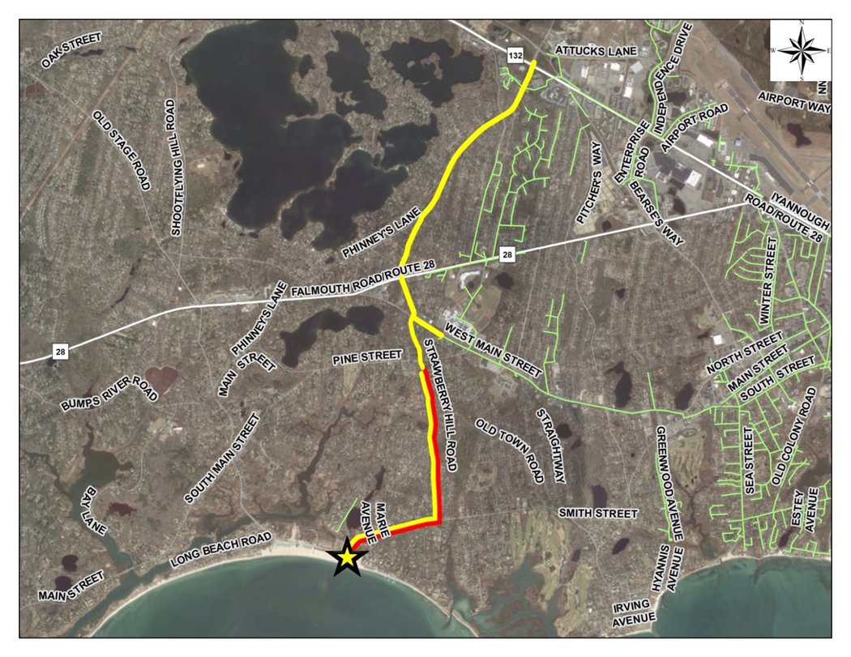
Example of What Could Be Considered GBF Costs - Proposed Infrastructure Along Vineyard Wind Route
19,000 LF of Gravity Sewer
9,300 LF of Sewer Force Main
1 New Sewer Pump Station (Covell’s Beach)

Slide 16
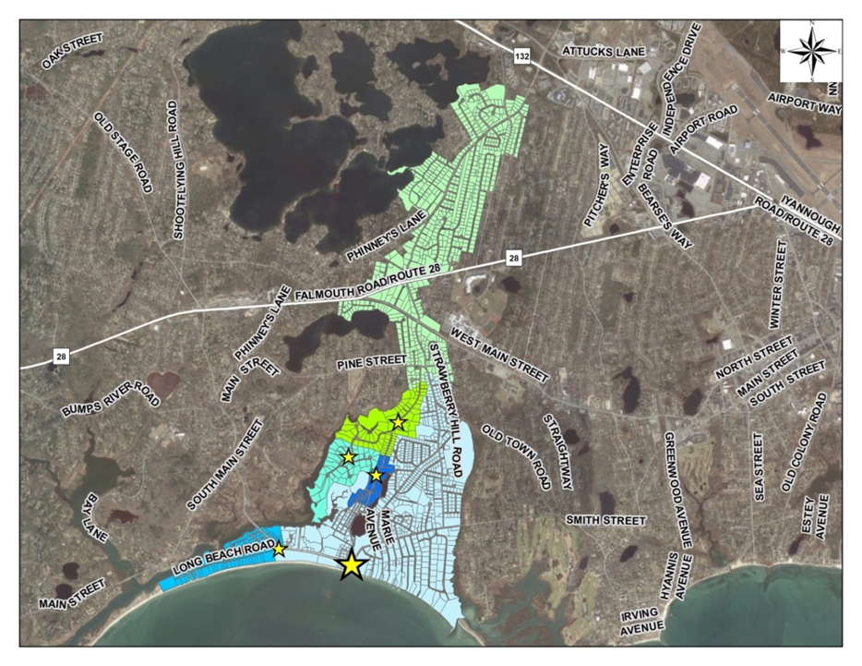
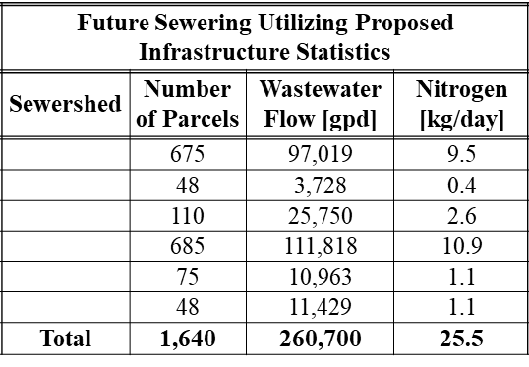
Pumping Area Served By Vineyard Wind Route

Slide 17
Sewer Assessments
Financing plan assumes an average sewer assessment of $18,000 amortized over 30 years with a 2.5% rate of interest
Propose an upper limit of $20,000 be placed on the assessment; indexed for inflation
Propose to allow property owner to apportion to future tax bills for up to 30 years
Interest rate can be set at a rate up to 2 per cent above the net rate of interest chargeable to the town for the project to which the assessment relates

Slide 18
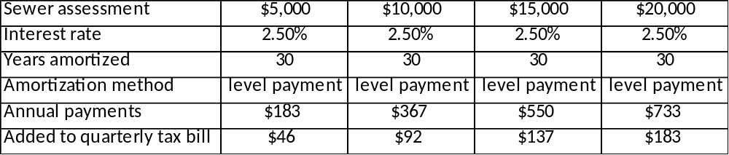
Sample Sewer Assessments

Slide 19
Systems Development Charges (SDC)
A fee in the utility industry that is charged to new customers of a utility system to pay for the investments made into the “backbone” of a system for the capacity consumed by the new user
Financing plan includes a $2,000 SDC that would be paid at the time of connection to the sewer system
Offsets a portion of the investment already made to create existing capacity and $224 million investment in expanded capacity for treatment
Notes:
3 methods to calculate
Historical buy-in method – typically used when the existing system has sufficient capacity to serve new development now and into the future
Incremental cost method – typically used when the existing system has limited or no capacity to serve new development and new facilities are needed to serve the next increment of new development
Combined approach – typically used where some capacity is available in parts of the existing system, but new or incremental capacity will need to be built in other parts to serve new development in the near future

Slide 20
Sewer Utility Charges
30 year plan estimates 9812 new connections to the sewer system
Financing plan assumes 100% connected within 2 years of sewer line completion
Average residential sewer bill is currently $400
At full buildout $10 million in annual revenue

Slide 21
General Fund Contribution
Financing plan includes a $3 million annual contribution from the General Fund
  Contribution begins in FY 2022 at $300,000; increasing $300,000 per year for 10 years until it reaches $3 million annually
Can be accomplished in several ways
  Redirect a portion of the existing tax levy or other general fund revenue source
  Dedicate certain categories of revenue growth to the program
  Reduce expenditures in certain areas
  Raise tax levy
    Tax levy override
    Debt exclusion
    Capital exclusion
Some combination of all

Slide 22
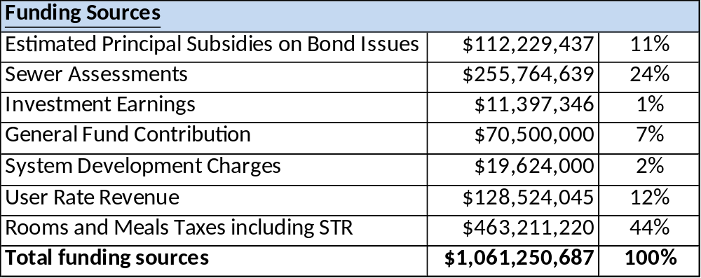
Summary of Funding for CWMP

Slide 23
Cost to Property Owner
3 components associated with buildout
  Sewer assessment – assessed by town after project completion – option to add to tax bill over 30 years
  System Development Charge – paid to the town at the time of connection
  Connection cost – paid to private contractor
Once connected a quarterly sewer utility bill will occur based on usage

Slide 24
Homeowner Assistance
Allow for 30 year amortization of sewer assessment at low interest rate
Create a Revolving Loan Fund to finance connection cost and System Development Charge
  Requires capital investment into fund for several years
  Loans issued for 10 years at 5% interest similar to county septic loan program
  Interest is reinvested into loan program and to cover administrative costs
Possibility of managing the connection program

Slide 25
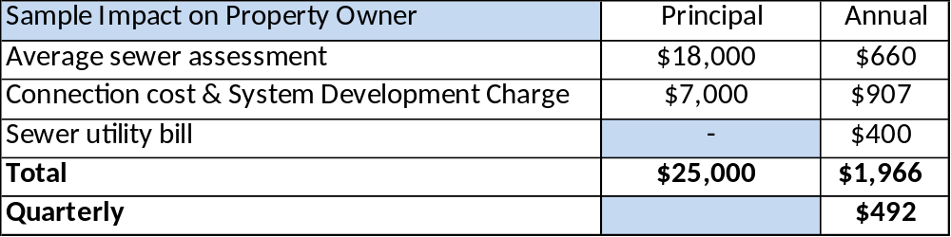
Sample Cost to Property Owner

Slide 26
Policy Decisions
How will the town differentiate General Benefit Facility costs from Specific Benefit Facility costs?
What assessment method will be used for allocating those costs?
What limit, if any, will be set on the maximum amount for a sewer assessment?
What interest rate will be charged on sewer assessments?
Will amortization period will be used sewer assessments?
When will a property abutter be required to hookup?
Notes:
Decisions not needed for the filing of the CWMP
Will the Fixed Uniform Rate or Uniform Unit method be used for sewer assessments?

Slide 27
Policy Decisions - Continued
Will bond amortization be authorized beyond 20 years?
Will the General Fund contribute to the program? If so;
  How much?
  What mechanism will be used?
Will a Systems Development Charge be included?
Should the town pursue special legislation to create a revolving loan program?
  Amortization period and loan rate?
Should the town administer a connection program?

Slide 28
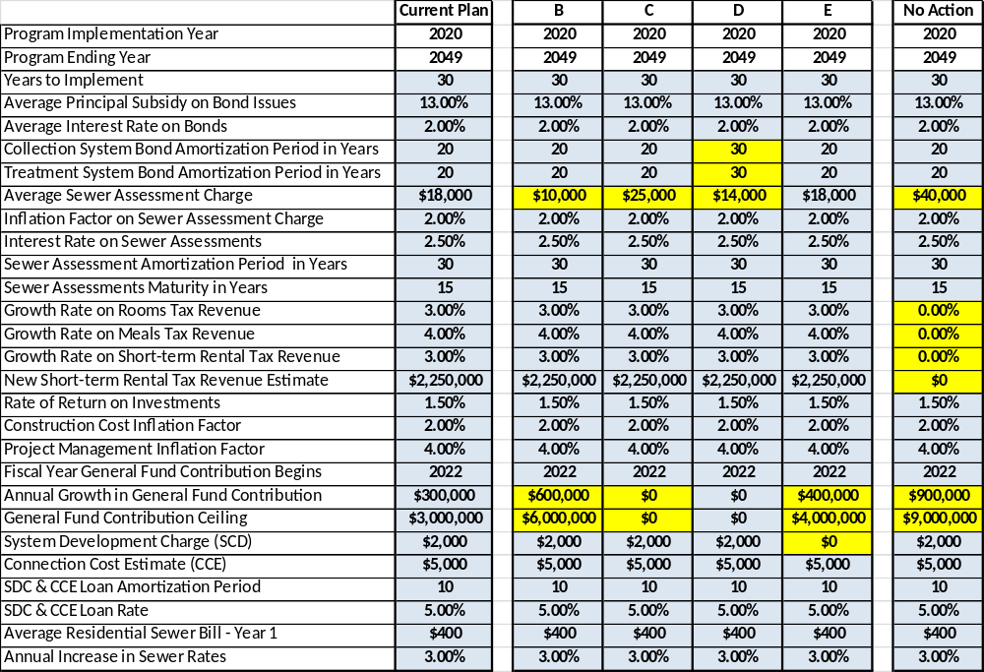
Examples of Alternative Assumptions

